Slide 1
Lecture 2: DART
SEB-312
Sidra Khatoon

Slide 2
What is Dart?
Dart is a general-purpose, high-level modern programming language which is originally developed by Google.
It is the new programming language which is emerged in 2011, but its stable version was released in June 2017.
Dart is not so popular at that time, but It gains popularity when it is used by the Flutter.
Dart is a flexible, object-oriented programming language with features like closures and static scope. Its syntax is similar to Java, C, and JavaScript, making it easy to learn if you're familiar with these languages.
In programming, a closure is a function that retains access to variables from its static scope (the scope in which it was created) even after the outer function has finished executing.
Dart is an open-source programming language which is widely used to develop the mobile application, modern web-applications, desktop application, and the Internet of Things

Slide 3
Dart History
Dart was revealed for the first time in the GOTO conference in the month of October 2011 at Aarhus, Denmark. It is initially designed by the Lars bark and Kespar and developed by Google.
The first version 1.0 of Dart was released on November 14th, 2013, intended as a replacement of JavaScript
In July 2014, the first edition of Dart language was approved by ECMA International at its 107th General Assembly.
The first version was criticized due to a malfunction on the web and this plan was dropped in 2015 with the 1.9 release of Dart.
The second version of Dart 2.0 was released in August, including a sound type system.
The recent version Dart 2.7 is supplemented with the extension method, which enables us to add any type of functionality.

Slide 4
Why dart
Dart is a platform-independent language and supports all operating systems such as Windows, Mac, Linux, etc.
It is an open-source language, which means it available free for everyone. It comes with a BSD license and recognized by the ECMA standard.
It is an object-oriented programming language and supports all features of oops such as inheritance, interfaces, and optional type features.
Dart is very useful in building real-time applications because of its stability.
Dart comes with the dar2js compiler which transmits the Dart code into JavaScript code that runs on all modern web browser.
The stand-alone Dart VM permits Dart code to run in a command-line interface environment.

Slide 5
Features
Everything in Dart is treated as an object including, numbers, Boolean, function, etc. like Python. All objects inherit from the Object class.
Dart tools can report two types of problems while coding, warnings and errors. Warnings are the indication that your code may have some problem, but it doesn't interrupt the code's execution, whereas error can prevent the execution of code.
Dart supports generic types, like List<int>(a list of integers) or List<dynamic> (a list of objects of any type).

Slide 6
features

Slide 7
Getting Started
Dart is easy to learn if you know any of Java, C++, JavaScript, etc.
The simplest "Hello World" program gives the idea of the basic syntax of the programming language. It is the way of testing the system and working environment.
There are several ways to run the first program, which is given below:
– Using Command Line
– Running on Browser
– Using IDE

Slide 8
Hello World
void main() {
print("Hello World!");
}

Slide 9
Identifiers
Identifiers are the name which is used to define variables, methods, class, and function, etc.
An Identifier is a sequence of the letters([A to Z],[a to z]), digits([0-9]) and underscore(_), but remember that the first character should not be a numeric.
The first character should not be a digit.
Special characters are not allowed except underscore (_) or a dollar sign ($).
Two successive underscores (__) are not allowed.
The first character must be alphabet(uppercase or lowercase) or underscore.
Identifiers must be unique and cannot contain whitespace.
They are case sensitive. The variable name Ali and ali will be treated differently.

Slide 10
Printing and String Interpolation
The print() function is used to print output on the console, and $expression is used for the string interpolation. Below is an example.
void main()
{
var name = “Ali";
var marks = 78.56;
print("My name is ${name} My marks are ${marks}");
}

Slide 11
Data Types
The data types are the most important fundamental features of programming language.
In Dart, the data type of the variable is defined by its value.
The variables are used to store values and reserve the memory location.
The data-type specifies what type of value will be stored by the variable. Each variable has its data-type.
The Dart is a static type of language, which means that the variables cannot modify.

Slide 12
Data Types
Dart supports the following built-in Data types.
– Number
– Strings
– Boolean
– Lists
– Maps
– Runes
– Symbols

Slide 13
Operators

Slide 14
Arithmetic Operators
+
-
*
/
%
Unary –

Slide 15
Arithmetic Operators
void main(){
print("Example of Assignment operators");
var n1 = 10;
var n2 = 5;
print("n1+n2 = ${n1+n2}");
print("n1-n2 = ${n1-n2}");
print("n1*n2 = ${n1*n2}");
print("n1/n2 = ${n1/n2}");
print("n1%n2 = ${n1%n2}");
}

Slide 16
Assignment Operators
=
+=
-=
*=
~/=
%=

Slide 17
Control flow statement
Control flow statement can be categorized mainly in three following ways.
– Decision-making statements
– Looping statements
– Jump statements

Slide 18
If statement
if (condition) {
//statement(s)
}

Slide 19
If – else statement
if(condition) {
// statement(s);
}
else {
// statement(s);
}

Slide 20
If – else – if statement
if (condition1) {
// statement(s)
}
else if(condition2) {
// statement(s)
}
else if (conditionN) {
// statement(s)
}
else {
// statement(s)
}

Slide 21
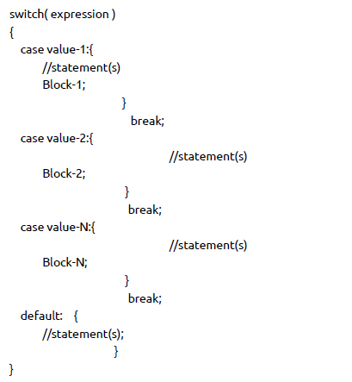
Switch Statement

